Slide 1
How Cells Feel
Modelling Interactions of Cells with Their Environment
Directed Reading Program
Mentor: Gordon Robert McNicol
Mentees: Kris Zhang & Margaret Puzio
4.1.2026
Notes:
Hi everyone, today we’ll be talking about how cells interact with their environment, specifically through a process called mechanotransduction.
Our goal was to understand how cells don’t just passively exist, But actually sense and respond to mechanical signals such as stiffness or structure in their environment.
We approached this using a mathematical model made up of coupled differential equations to capture both the biological and mechanical interactions happening inside the cell.

Slide 2
Why Mechanotransduction?
Cells are not passive
They actively sense and respond to the physical properties of their environment (e.g., ECM) — stiffness, geometry, etc.
Mechanical cues drive cell fate
Mesenchymal stem cells — multipotent progenitor cells that can differentiate into a variety of cell types — follow different lineages depending on substrate stiffness: soft substrates promote neurogenesis (the formation of brain tissue), while stiff substrates promote osteogenesis (the formation of bone).
Clinical relevance
Mechanosensing is also implicated in fibrosis, cancer metastasis, and cardiovascular disease. Understanding the signaling pathways opens doors for targeted therapies.
Mathematical modelling
The coupled biochemical-mechanical system is complex, and reduced systems consisting of only ODEs have been shown to capture must of the observed behavior of cell-substrate interaction.
Notes:
So first, why does this matter?
Cells are not passive. they actively sense things like stiffness and geometry in their environment.
These mechanical signals actually influence what cells become. For example, stem cells can turn into brain cells on softer surfaces, or bone cells on stiffer ones.
This is also important in diseases like cancer or fibrosis, where cell behavior becomes abnormal.
Because this system is so complex, we use mathematical models, specifically a systems of differential equations to simplify and understand how all these interactions work together.

Slide 3
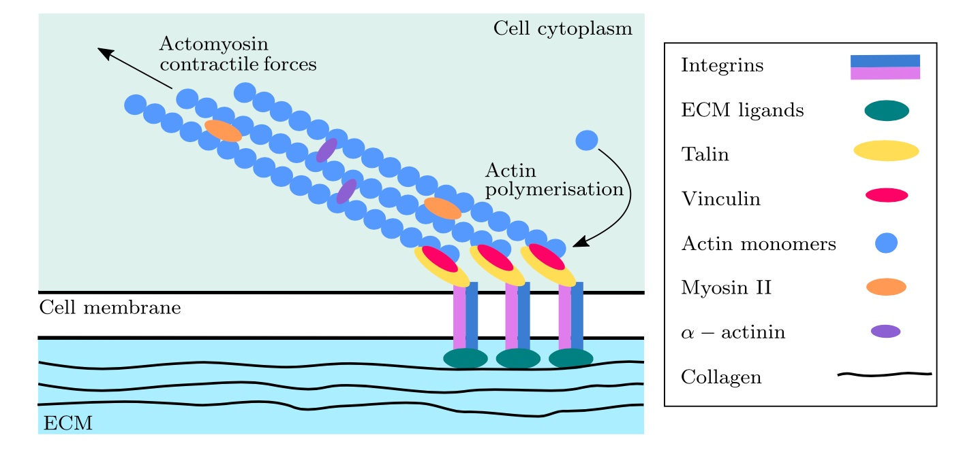
The Cell–ECM Interface
Integrins bind ECM ligands to form nascent adhesions
Adhesions mature into focal adhesions via stress fibre–mediated forces
Rho/ROCK signalling activates myosin II and suppresses actin depolymerisation
Positive feedback: FAs → ROCK → stress fibres → more FAs
Notes:
This slide shows how the cell physically connects to its environment through integrins, which form initial weak adhesions.
It starts with integrins — transmembrane receptors. When talin binds to an integrin, it activates it, giving it high affinity for ECM ligands. When binding happens, a nascent adhesion forms.
These are initially weak, but as stress fibres inside the cell generate force, the adhesions mature into focal adhesions through vinculin recruitment.
The Rho/ROCK pathway amplifies this. ROCK promotes myosin activation and stabilises actin.
This creates a positive feedback loop — adhesions activate ROCK, ROCK drives stress fibres, stress fibres strengthen adhesions, and the cycle continues. This loop is the core of our model.

Slide 4
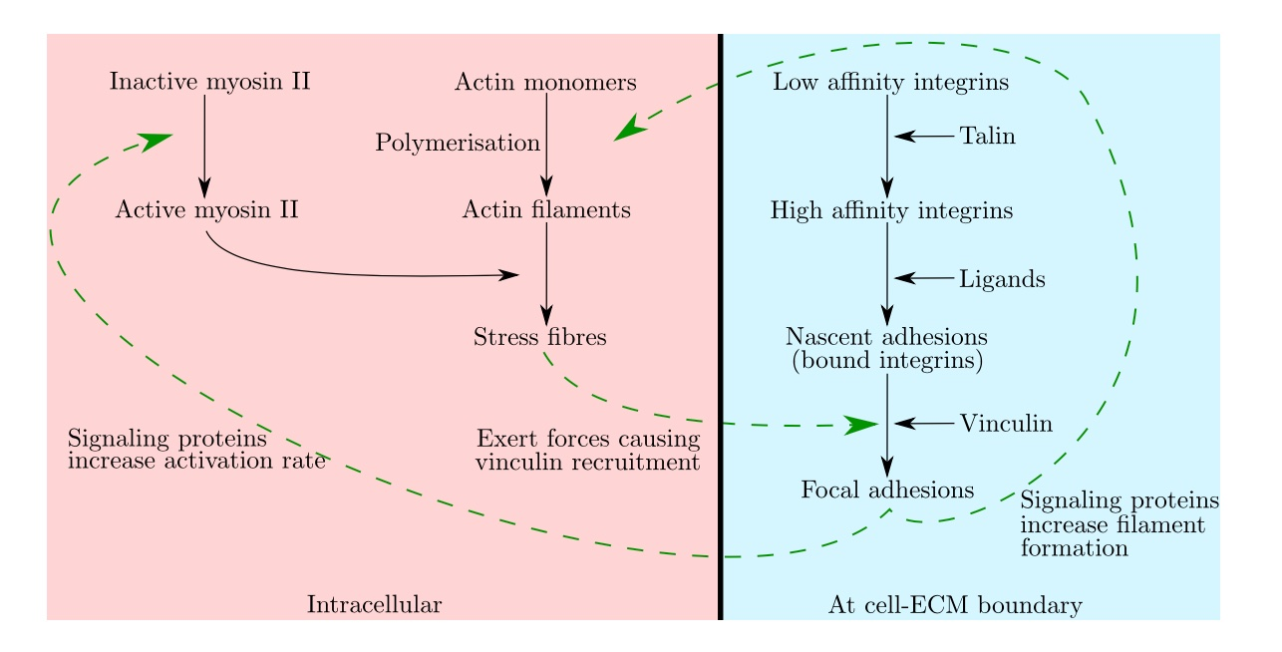
The Reaction Network
Intracellular
Actin monomers polymerise into filaments, then cross-link with myosin II to form contractile stress fibres.
Cell–ECM Boundary
Integrins switch affinity, bind ligands to form nascent adhesions, then mature into focal adhesions via vinculin recruitment.
Feedback (dashed)
Signalling proteins couple both sides: SFs drive adhesion maturation, and adhesions drive signalling.
Notes:
This diagram shows the full reaction network behind the model.
Inside the cell, G-actin monomers polymerise into F-actin filaments, which then cross-link with activated myosin II to form contractile stress fibres.
At the cell-ECM boundary, free integrins switch to high affinity, bind ECM ligands to form nascent adhesions, and then mature into focal adhesions.
The dashed arrows are the feedback connections. Stress fibres drive adhesion maturation through force, and adhesions drive signalling through Rho and ROCK. This bidirectional coupling is what makes a mathematical model necessary.

Slide 5
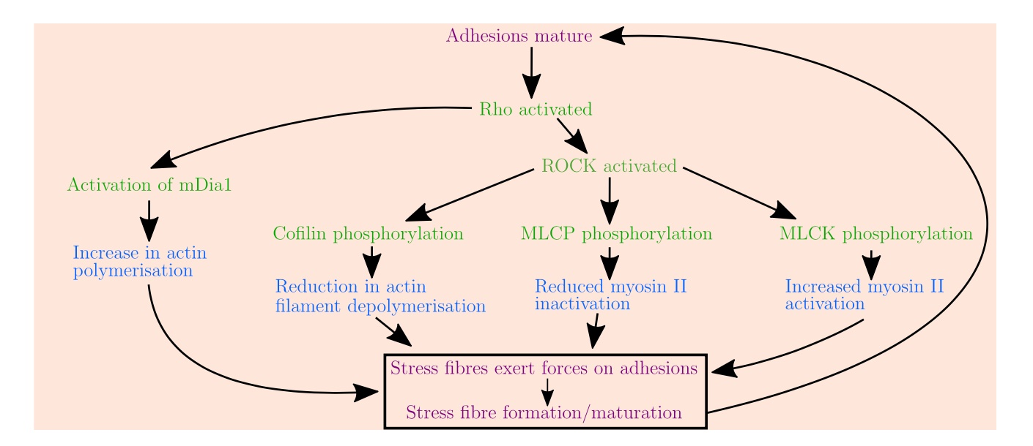
The Signaling Cascade
How ROCK drives the system
1.
Adhesion maturation activates Rho → ROCK
2.
ROCK phosphorylates cofilin: reduces F-actin depolymerization
3.
ROCK phosphorylates MLCP: reduces myosin inactivation
4.
ROCK phosphorylates MLCK: increases myosin activation
5.
mDia1 activation: increases actin polymerization rate
6.
Net result: more stress fibers → more adhesion maturation
This cascade is captured by a system of 18 coupled ODEs, where each arrow represents a reaction rate that feeds back into the system.
Since stretch and forces are not explicitly modelled, adhesion maturation is instead driven by stress fibers concentration as a mechanical proxy.
Notes:
Let's zoom into how ROCK drives the system.
Adhesion maturation activates Rho, which activates ROCK. ROCK then acts on several downstream targets.
It phosphorylates cofilin, which stabilises actin filaments by reducing depolymerisation.
It phosphorylates MLCP, which keeps more myosin in its active form.
And it phosphorylates MLCK, which directly increases myosin activation.
On top of this, Rho activates the formin mDia1, boosting actin polymerisation.
The net result is more stress fibre assembly, which drives more adhesion maturation, completing the positive feedback loop.
This cascade is captured by 18 coupled ODEs. One key simplification — since we don't model forces explicitly, stress fibre concentration acts as a mechanical proxy for adhesion maturation.

Slide 6
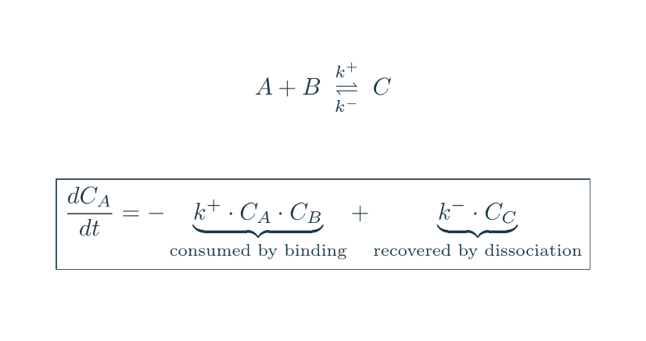
The Mathematical Model
18 coupled ODEs describing:
Cytoskeleton (3 eqs)
G-actin, F-actin, VSFs
Myosin II (2 eqs)
Inactive & activated myosin
Adhesion (5 eqs)
Free, high-affinity, bound integrins, FAs, substrate sites, ligands
Signaling (8 eqs)
ROCK, MLCP, MLCK, cofilin (each active/inactive)
Notes:
Here is the model — 18 coupled ODEs in four groups.
The cytoskeleton: three equations for G-actin, F-actin, and stress fibres — tracking how monomers polymerise and bundle into contractile structures.
Myosin: two equations for inactive and active myosin II, controlled by MLCK and MLCP.
Adhesion: five equations tracking integrins from free, to high-affinity, to bound, plus focal adhesions and available substrate sites.
Signalling: eight equations for ROCK, MLCP, MLCK, and cofilin, each in active and inactive forms.
All parts are coupled. Changes in one component propagate through the whole system.

Slide 7
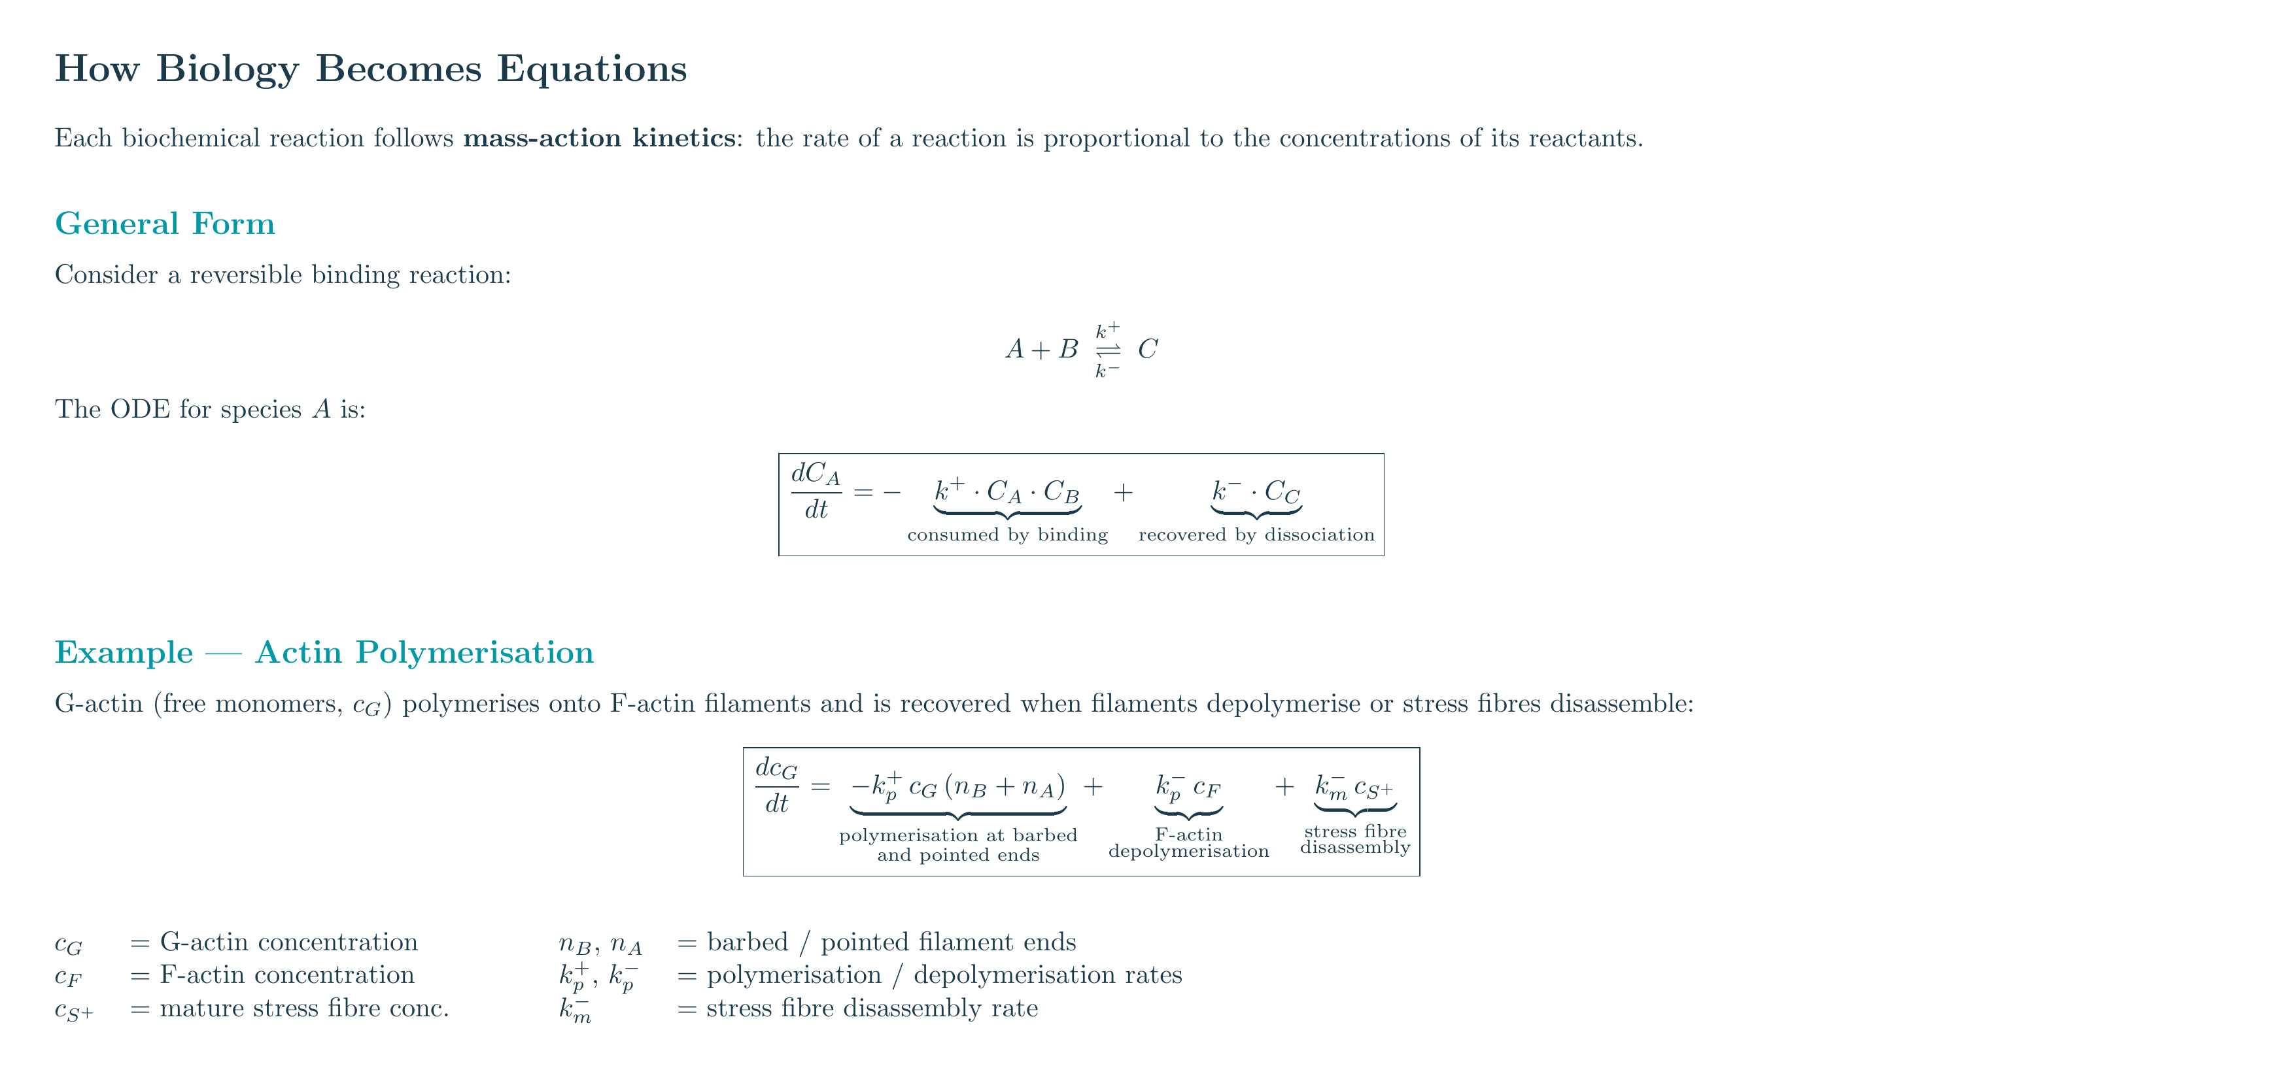
Notes:
These are the cytoskeleton and myosin equations.
G-actin is consumed by polymerisation into F-actin. F-actin is consumed by cross-linking with activated myosin to form stress fibres. The rates are modulated by signalling proteins — cofilin affects depolymerisation, mDia1 affects polymerisation.
The myosin equations describe activation by MLCK, deactivation by MLCP, and consumption by the cross-linking reaction. These couplings make the system nonlinear, so we solve numerically.

Slide 8
Notes:
This continues with the adhesion and signalling equations.
The adhesion equations follow the integrin lifecycle from free to bound, with the maturation step depending on stress fibre concentration.
The signalling equations track four protein pairs — ROCK, MLCP, MLCK, and cofilin — each with activation driven by upstream signals.
Together, these 18 equations form a complete closed system.

Slide 9
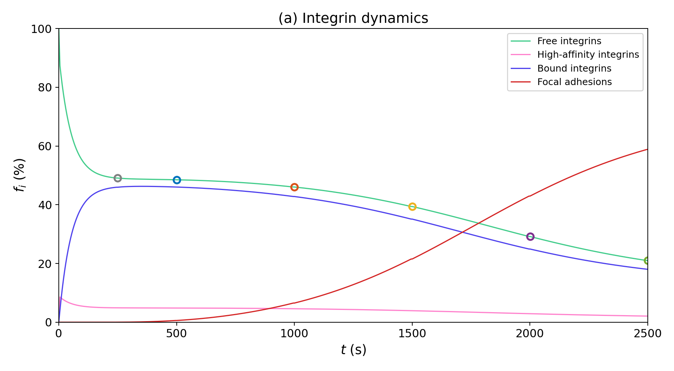
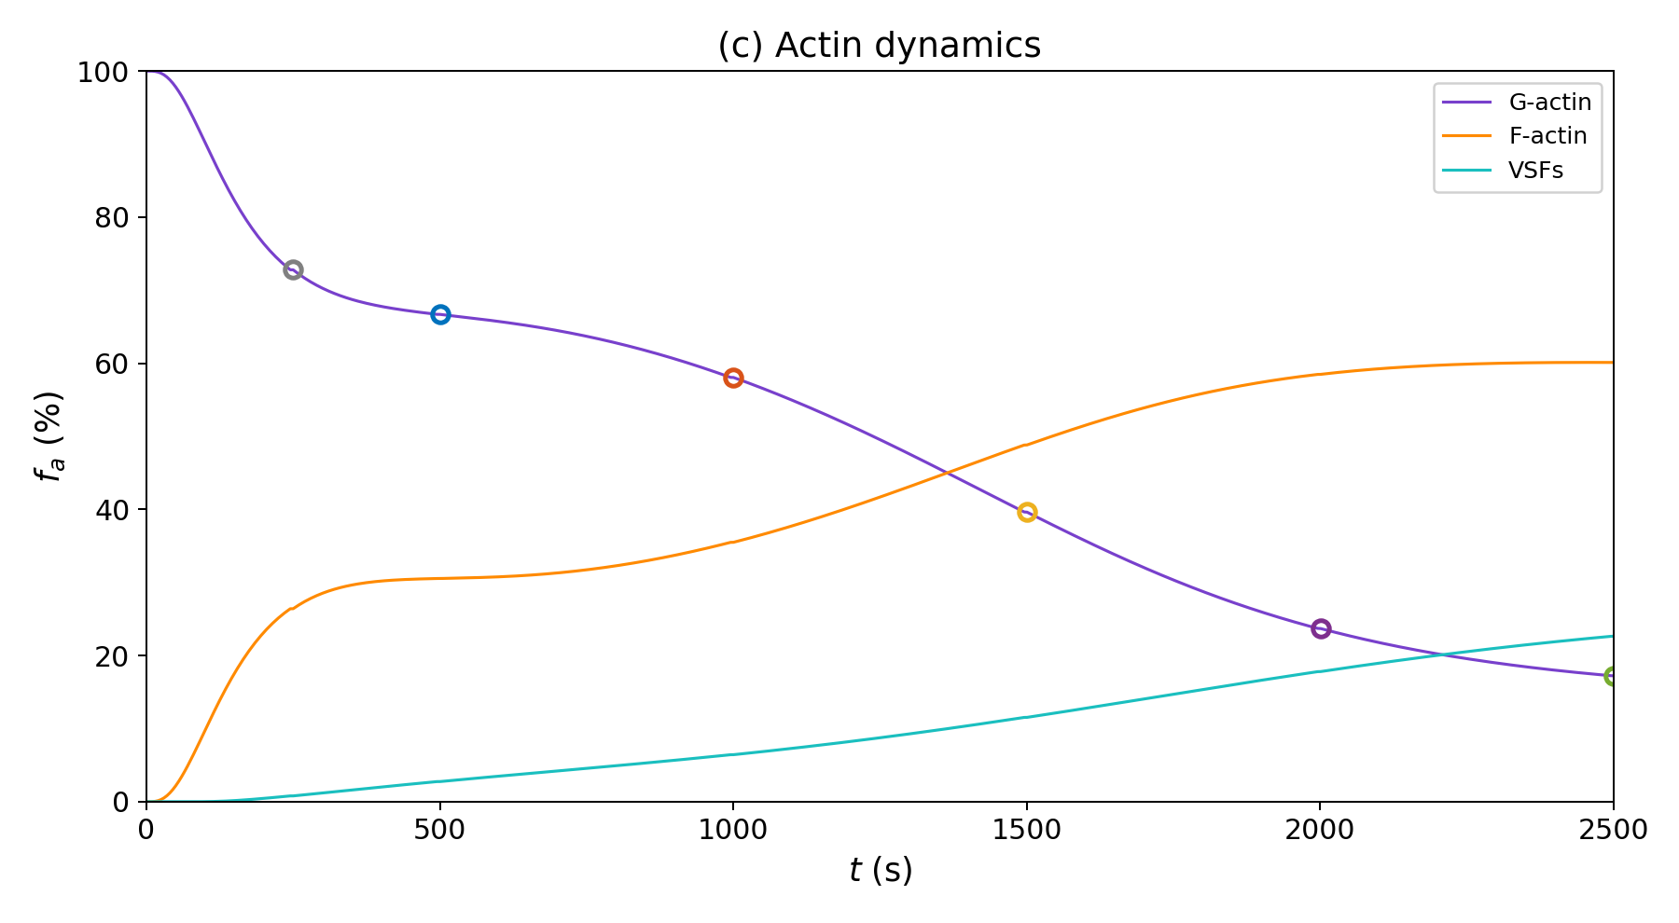
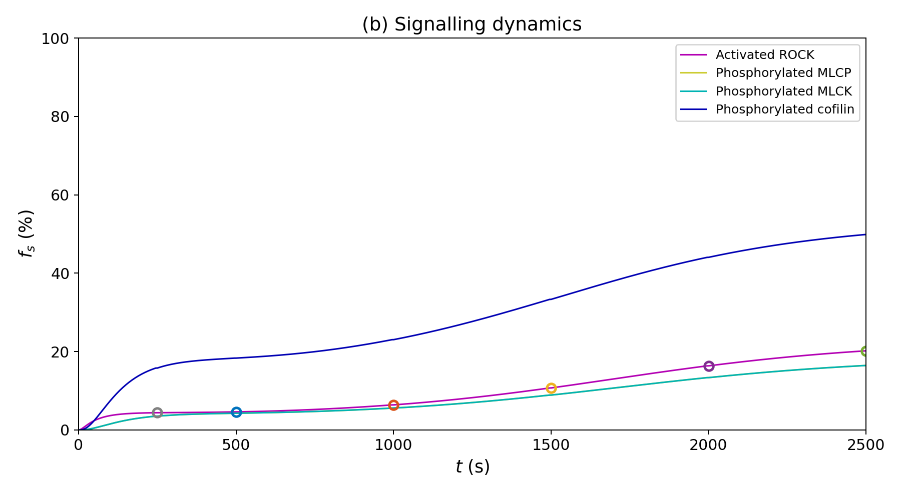
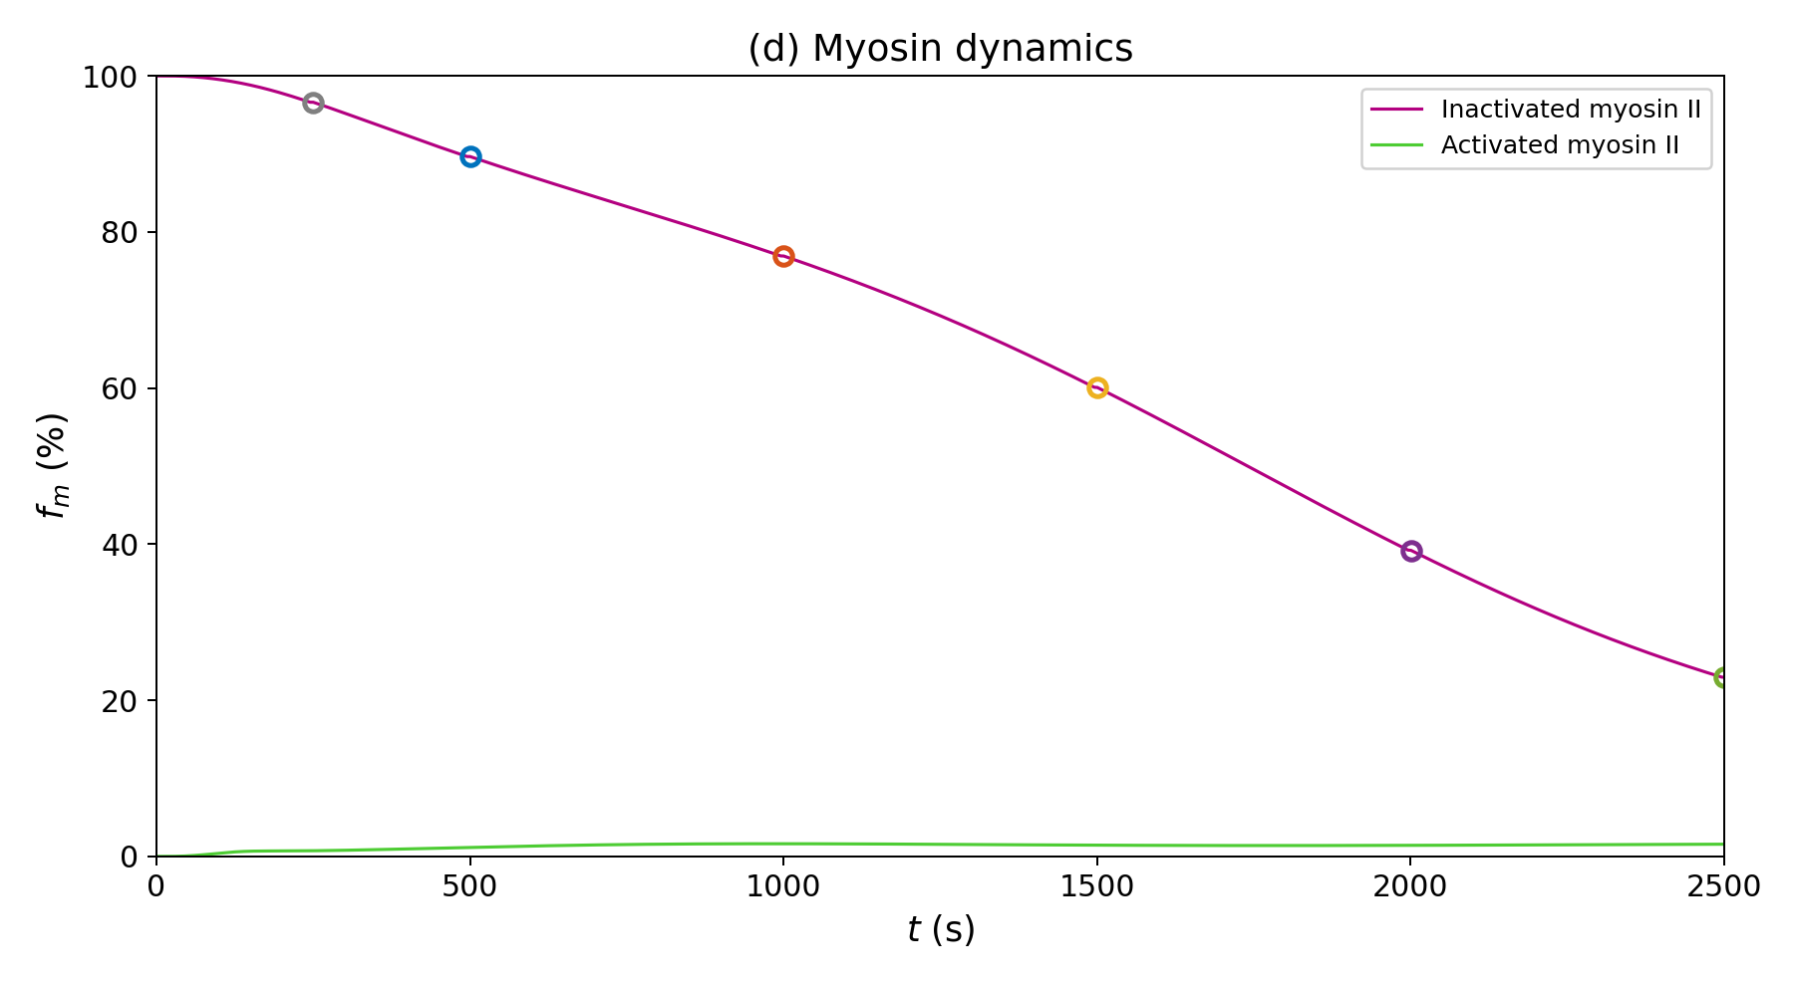
Baseline: Adhesion & Cytoskeleton Assembly
Notes:
These graphs show the baseline behaviour over time.
Free integrins are consumed as they transition to bound states. Focal adhesions build up. G-actin decreases as stress fibres accumulate. Signalling proteins activate as expected from the cascade.
One notable result — activated myosin reaches only about 2 to 3 percent of total myosin at steady state. The cross-linking reaction consumes it almost as fast as it's produced.
The key point is that the system reaches a stable steady state, in real cells, this won’t happened, but the model is only intended to be used to capture the start of what the cells happened.

Slide 10
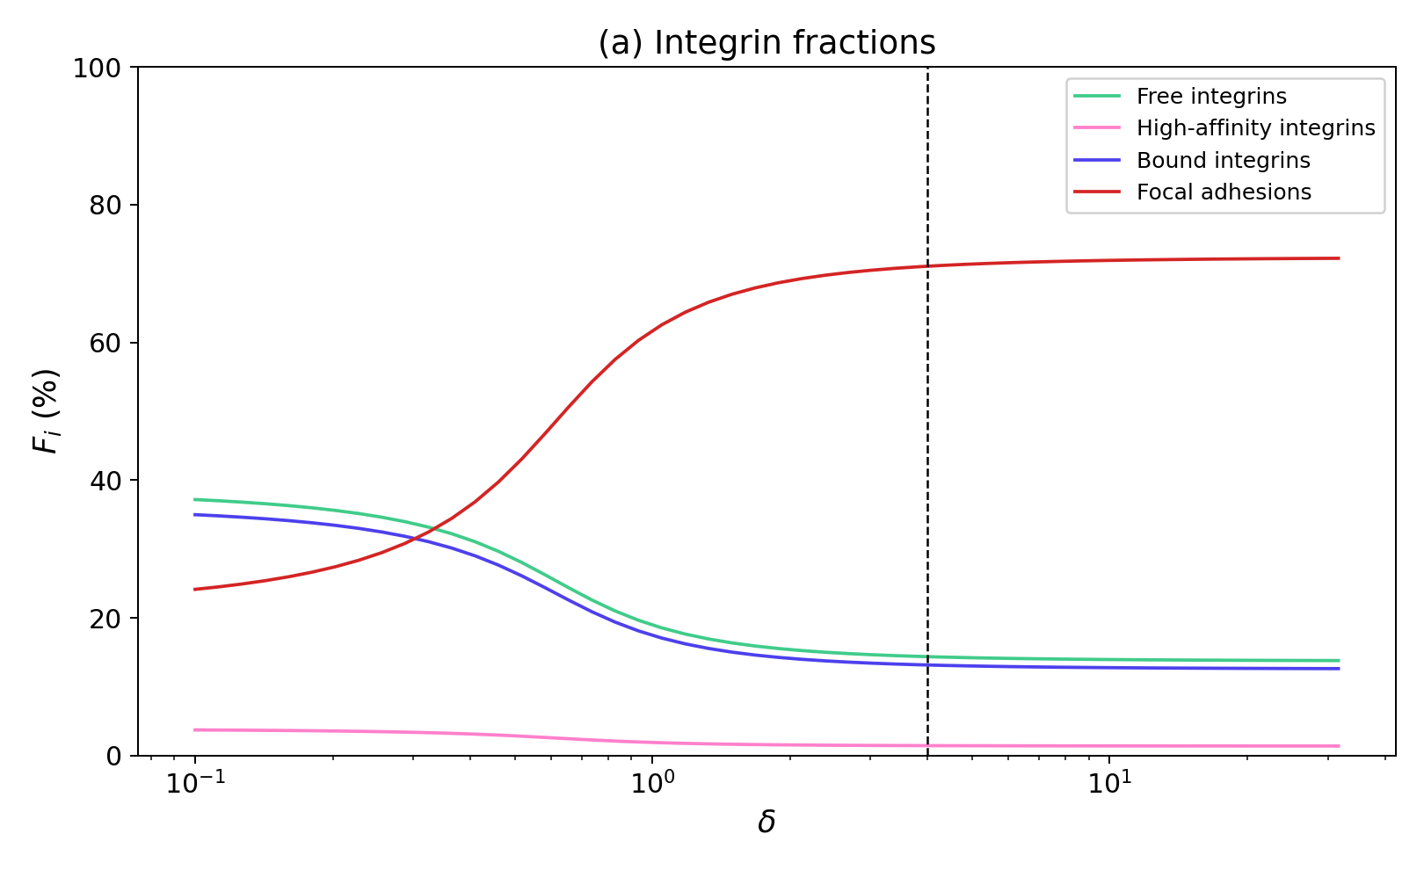
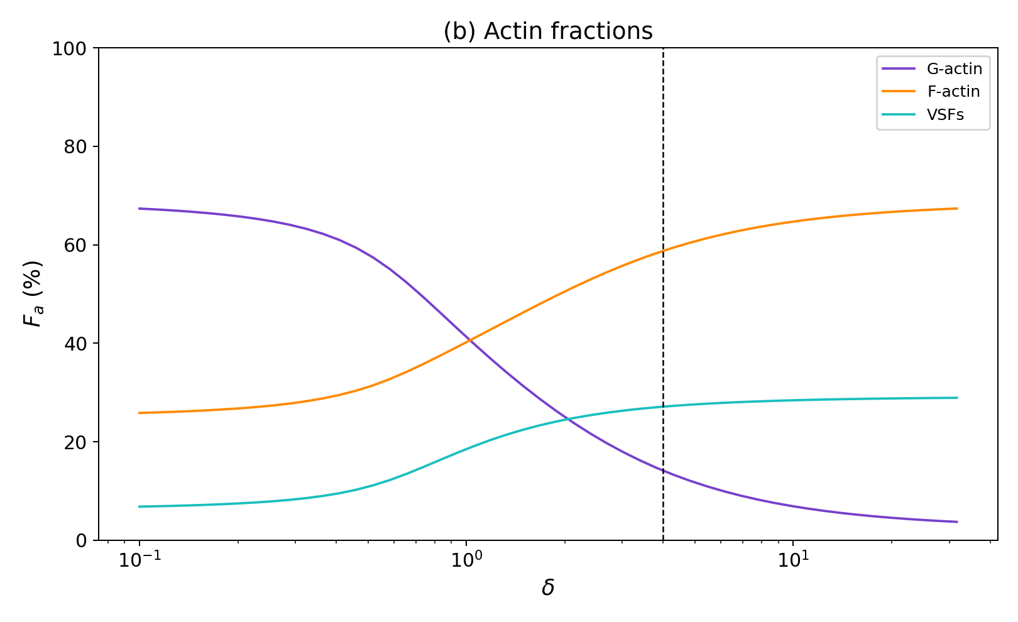
Sweep 1: δ — FA Feedback Strength
kR+ = KR+(nB + δ nA) | Sweep: δ ∈ [0.1, 31.6] | Baseline: δ = 4 (dashed line)
δ — Internal feedback strength
δ sits at the heart of the positive feedback loop. Changing it asks: how sensitive is the cell to its own signaling? Does the system need strong feedback to function, or is it robust?
Understanding feedback robustness matters for diseases where signalling is dysregulated — e.g., fibrotic cells with high ROCK activity.
Notes:
Now we move to parameter sweeps, starting with delta — the internal feedback strength from adhesions to ROCK activation.
We swept delta over two orders of magnitude and see a switch-like response. Below roughly delta equals 1, the feedback is too weak and the system collapses. Above that, it quickly saturates.
The baseline value of 4 sits well within the saturated regime. This means the cell is robust to small changes in its feedback strength.
This has implications for diseases like fibrosis, where ROCK activity is elevated. The model predicts that wouldn't change the steady state much, because the system is already saturated.

Slide 11
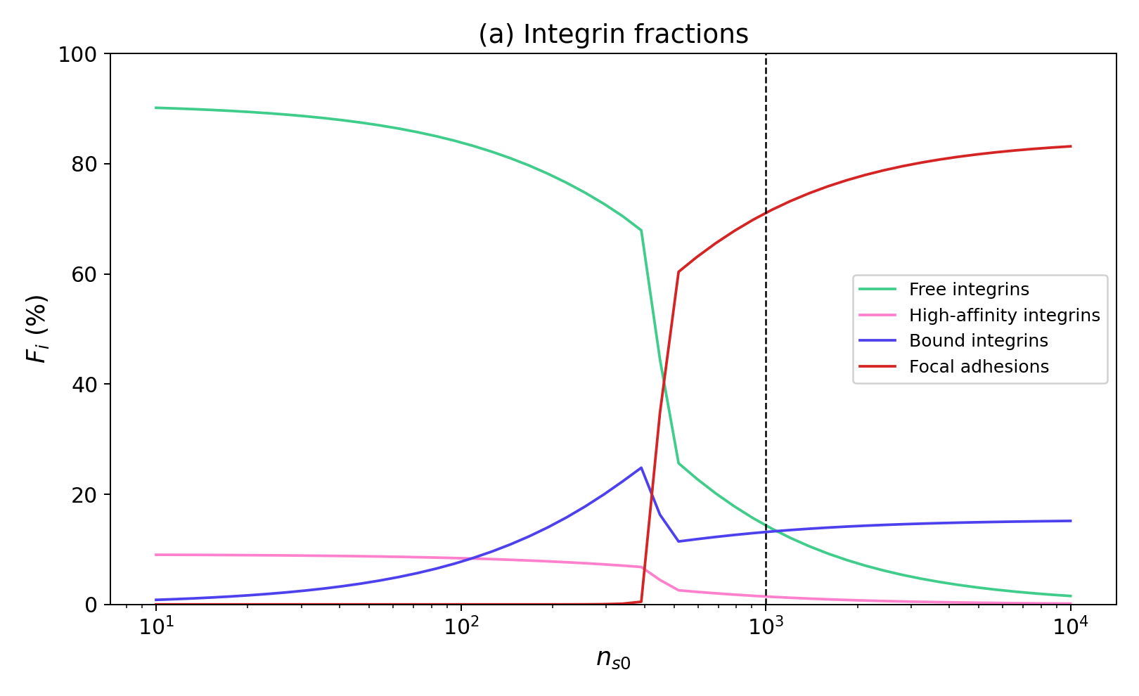
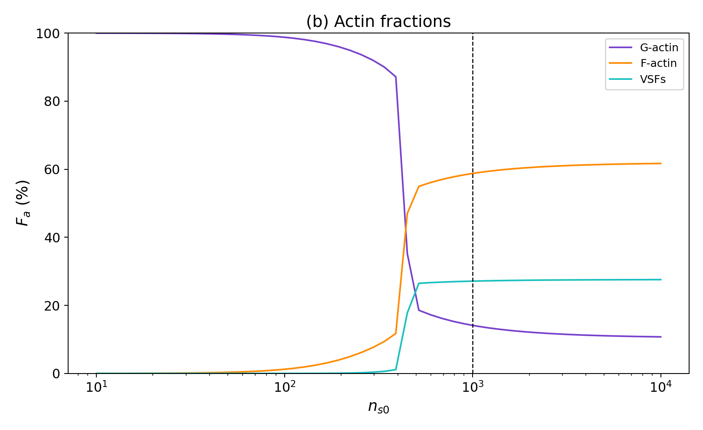
Sweep 2: ns0 — Substrate Ligand Density
ECM binding site density | Sweep: ns0 ∈ [10, 10000] | Baseline: ns0 = 1000 (dashed line)
ns0 — External environment (ECM density)
This is the upstream input the cell cannot control. Changing ns0 asks: what environmental conditions does the cell need to even begin mechanotransduction?
Directly relevant to tissue engineering — if you're designing scaffolds, you need to know the minimum ligand density for cell adhesion.
Notes:
The second sweep is on n_s0 — the density of ECM binding sites. This is an external parameter the cell cannot control.
This produces the steepest transition of all three sweeps. Below about 200 per micormetre squared substrate sites, the entire mechanotransduction cascade is off. Above that, it switches on sharply.
The steepness comes from a dual effect — fewer binding sites both reduce the binding rate and limit total possible adhesions, which compounds the weakening of the feedback loop.
This is directly relevant to tissue engineering. If you're designing scaffolds, our model predicts a clear minimum ligand density. Below it, cells simply won't adhere.

Slide 12
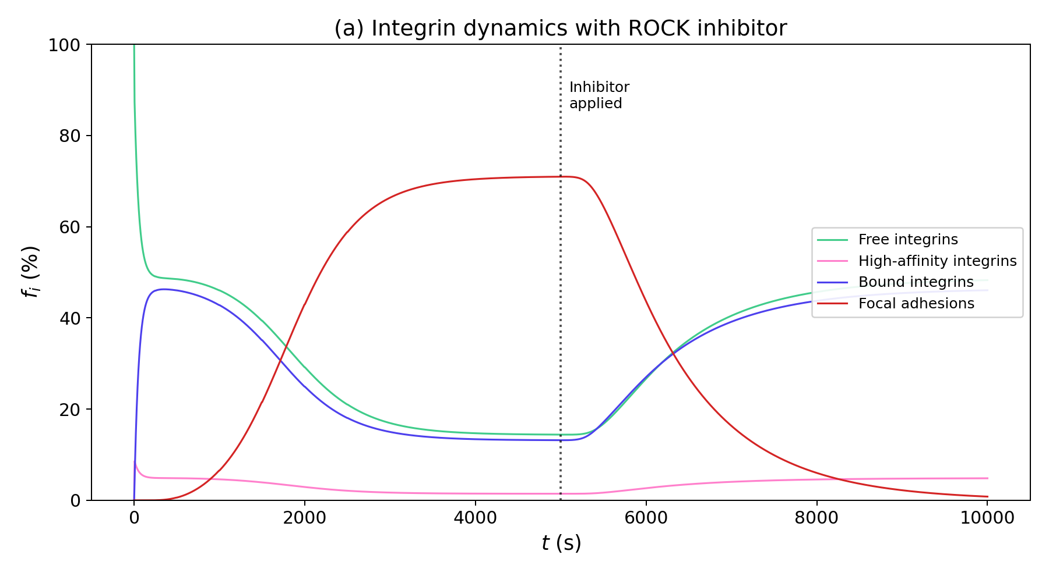
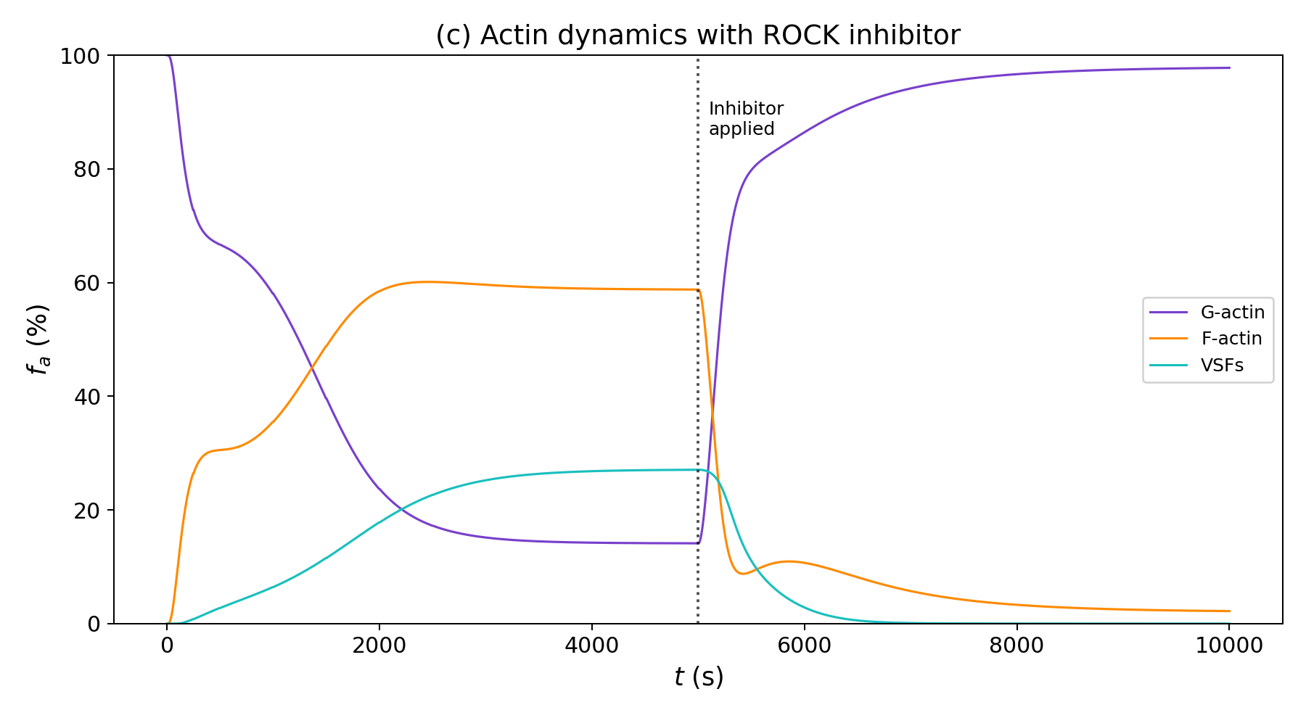
ROCK Inhibitor: Time-Series Response
Notes:
Before the dose-response sweep, let's see what happens when we add a ROCK inhibitor to a cell already at steady state.
ROCK activity drops. Myosin activation decreases. Stress fibres begin to disassemble, weakening adhesion maturation.
Interestingly, nascent adhesions actually increase — integrins still bind the ECM, but they can't mature into focal adhesions without stress fibre-generated force.
This is a specific, testable prediction — ROCK-inhibited cells should show more nascent adhesions but fewer or no focal adhesions. This could be verified with fluorescent cell imaging.

Slide 13
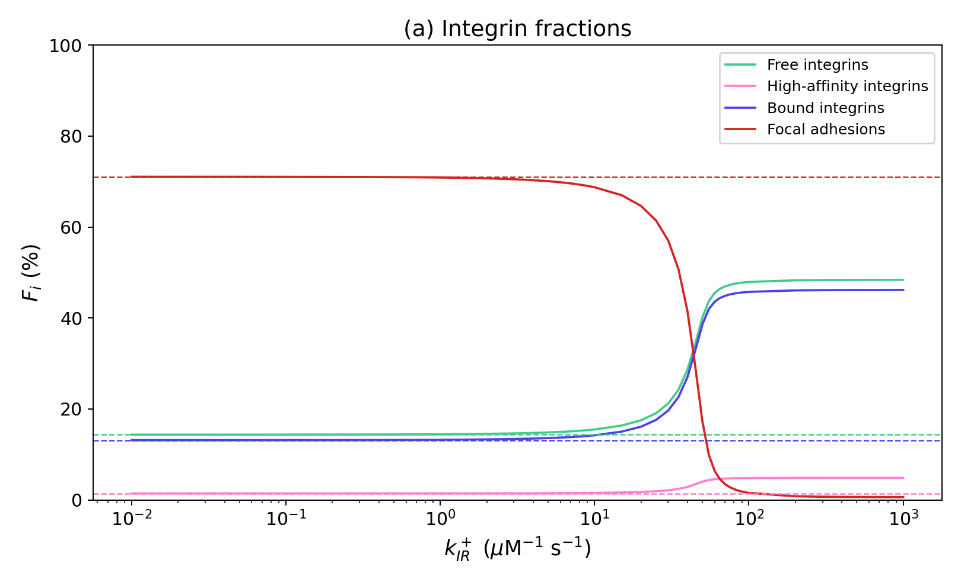
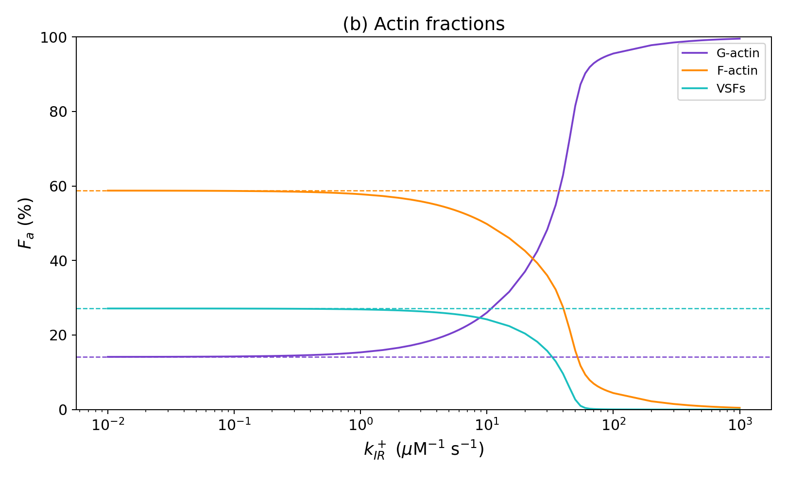
Sweep 3: kIR+ — Inhibitor Dose-Response
Inhibitor–ROCK binding rate | Sweep: kIR+ ∈ [0.01, 1000] μM⁻¹s⁻¹ | Dashed = uninhibited baseline
kIR+ — Pharmacological perturbation
ROCK inhibitors are real drugs used in research and clinical trials. This sweep asks: can we predict the dose-response curve from first principles?
Experimental titration data for ROCK inhibitors exists — our predictions could be directly compared and tested.
Notes:
Now we sweep the inhibitor binding rate over five orders of magnitude, effectively varying the dose.
The result is a smooth, dose-dependent reversal of the adhered state. As inhibitor increases, ROCK, stress fibres, and focal adhesions all decrease.
This is significant because ROCK inhibitors are real drugs. Our dose-response curve could be compared against experimental data.
The transition spans about two decades, suggesting a relatively narrow therapeutic window. Too little has no effect; too much abolishes adhesion entirely.

Slide 14
Key Findings
1
δ — Internal feedback architecture
Controls a positive feedback switch. The baseline δ = 4 sits in the saturated regime, meaning the cell is robust to small perturbations in feedback strength.
2
ns0 — External mechanical environment
Acts as a gatekeeper. Below ~200 substrate sites, the entire mechanotransduction cascade is off. The steepest transition of all three sweeps, due to dual rescaling effects.
3
kIR+ — Pharmacological intervention
ROCK inhibition reverses the adhered state dose-dependently. Integrins still bind but cannot mature — a specific prediction that could be tested microscopically.
✦
Universal observation: Myosin II quasi-steady state
Activated myosin stays at ~2–3% across ALL sweeps. It is consumed by the fast cross-linking reaction as fast as it is produced — a transient intermediate, not a bottleneck.
Notes:
Here are the main findings from our three sweeps.
Delta controls a switch-like response, and the baseline sits in the saturated regime — the cell is robust to perturbations in its own signalling.
n_s0 acts as a gatekeeper. Below about 200 binding sites, mechanotransduction is completely off. This was the steepest transition.
The ROCK inhibitor reverses adhesion dose-dependently. Integrins still bind but cannot mature — a testable prediction.
And across all sweeps, activated myosin stays at 2 to 3 percent. It's a transient intermediate, not a bottleneck — a non-obvious result from the coupled dynamics.

Slide 15
What This Tells Us
Why it matters
Broader significance
Tissue engineering
The model predicts that cells operate as bistable switches — they are either fully adhered or not at all. There is no halfway state. This has direct implications for understanding how cells commit to adhesion.
Knowing the ns0 threshold tells scaffold designers the minimum coating density required for cell adhesion — below this, no amount of signaling will help.
Drug development
The kIR+ dose-response curve provides a quantitative framework for predicting ROCK inhibitor efficacy. The two-decade transition width suggests a narrow therapeutic window.
The threshold behavior of ns0 explains why cells fail to spread on poorly coated substrates — not because spreading is gradual, but because the feedback loop simply cannot ignite below a critical ligand density.
Cancer biology
Tumour cells often show altered mechanosensing. This model framework could be extended to predict how mutations in ROCK or integrin pathways shift the adhesion switch point.
The inhibitor results predict a specific, testable signature: ROCK-inhibited cells should show increased nascent adhesions but no focal adhesions. This could be verified by immunofluorescence microscopy.
Mathematical insight
The activated myosin quasi-steady state is a non-obvious prediction that emerges from the coupled dynamics — it shows why simple rate-limiting-step intuition can be misleading in feedback systems.
Notes:
So what does this mean in the bigger picture?
The central insight is that cells behave as bistable switches — fully adhered or not at all, with no stable halfway state. This comes from the positive feedback loop between adhesions and stress fibres.
For tissue engineering, this gives a minimum coating density for scaffolds.
For drug development, the dose-response provides a quantitative framework for ROCK inhibitor efficacy, with a narrow therapeutic window.
In cancer biology, altered mechanosensing could shift the adhesion switch point.
And mathematically, the myosin quasi-steady state shows why simple rate-limiting-step intuition can be misleading in systems with feedback.

Slide 16
Thank You
Mentor: Gordon Robert McNicol
Presented by Kris Zhang & Margaret Puzio
Questions?
Notes:
Thank you for listening. We'd like to thank our mentor Gordon for guiding us through this project.
Happy to take any questions.

