Slide 1

MULTIPLE LINEAR REGRESSION
REPORT for S&P 500
Presented by Group 21
S&P 500®
Group 21: Kris Zhang, Patrick Luo, Antonio Melacini

Slide 2
S&P 500®
Table of Contents
Motivation
dataset description
Data Checking
Model selection
Model checking
Applications
Conclusion
Introduction of topic

Slide 3
S&P 500®
How Idea come out?
Imagine you could unravel the secrets of the most watched stock index in the world, the S&P 500. Every rise and dip of this index not only reflects the health of the U.S. economy but also dictates investment decisions across the globe. We aim to identify the hidden relationships and key drivers influencing the S&P 500……

Slide 4
S&P 500®
Question of Interest
Linear association between Price of S&P U.S. High Yield Corporate Bond Index and S&P500?
Linear association between the sector weighting of tech or industrials in the S&P500 and S&P500 Price?
Linear association between any of the selected macroeconomic variates and S&P500 Price?
If any of the above linear relationships above are statistically significant, any interaction term exist?

Slide 5
S&P 500®
Investigating potential Linear Associations with S&P 500 Price
Financial Variables
S&P U.S. High Yield Corporate Bond Index
Sector Weightings
Macroeconomic Variables
2, 5, 10-year Treasury Yield
U.S. Federal Funds Effective Rate
Yield Curve Spread

Slide 6

S&P 500®
Dataset Description
Time Range: 11.30.1994 to 12.31.2023
Aggregation Method: Last value of the month
Frequency: Monthly
Sample Size: n=350
Response Variate (y): S&P 500 Price
Covariates:
U.S. High Yield Corporate Bond Index
Tech weighted proportion of the S&P500
Industrials weighted proportion of the S&P500
U.S. Federal Funds Effective Rate
10-year treasury yield minus the 2-year treasury yield
U.S. treasury bonds of 2, 5, 10-year maturities

Slide 7


S&P 500®
Multicollinearity Analysis
Strong Negative Correlation
between Tech and Industrial Sector Weighting.

Slide 8

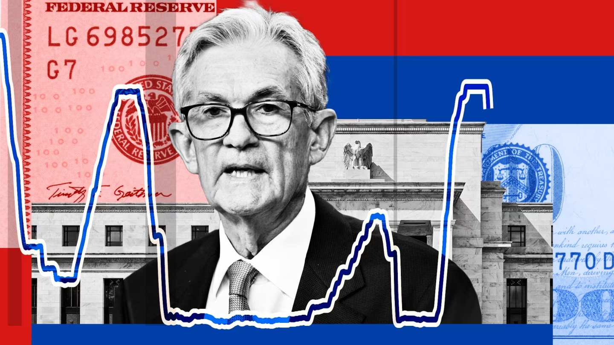
S&P 500®
Multicollinearity Analysis
Strong Positive Correlation between Treasury Bond and Fed Rate.

Slide 9
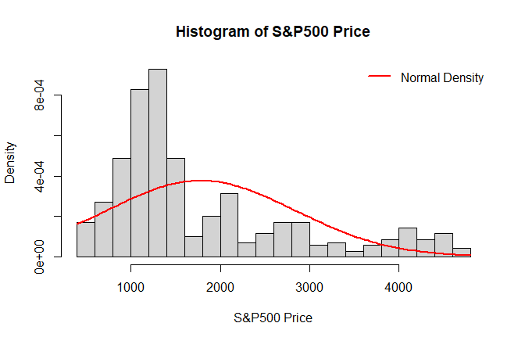
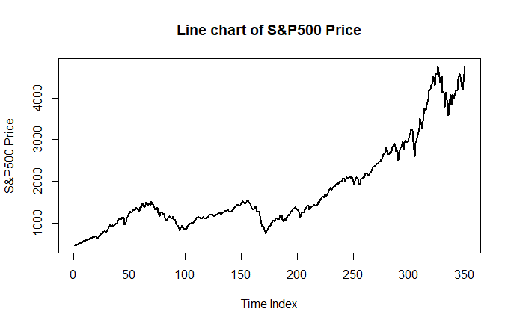
S&P 500®
Initial Analysis for Response Variate
Positive skew of the distribution
Distribution appears unimodal
Clearly Time-Dependent (Limitation)

Slide 10
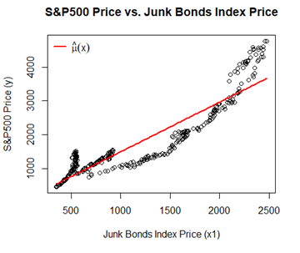

S&P 500®
Model 1: Junk Bonds Index ${(x}_{1})$
Strong positive linear association with $R_{adj}^{2}$=0.834
Statistically significant linear association with the S&P500 price at the 5% level, P-value<5%
${\hat{β}}_{1}≈$1.469 suggests that a $1 increase in the price of the junk bonds index is, on average, associated with a $1.469 increase in the price of the S&P500 index.

Slide 11
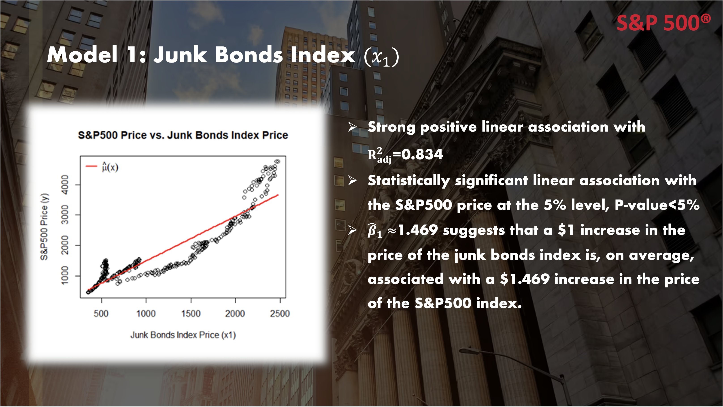

Slide 12


S&P 500®
Correlations for $x_{1}, y$, Tech and Industrial weight
Tech and industrial weight: high correlation, so consider them in separate model
Industrial weight performance better than Tech, but stronger collinearity with $x_{1}$
VIF between Tech and $x_{1}$ is 1.9992, indicate moderate multicollinearity

Slide 13
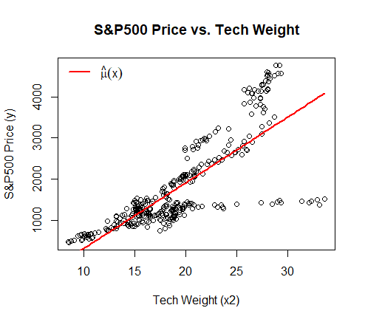

S&P 500®
Sector Weighting: Tech Weight Variate
$R_{adj}^{2}$=0.6213 moderately strong positive linear association
${\hat{β}}_{1}$= 159.910

Slide 14
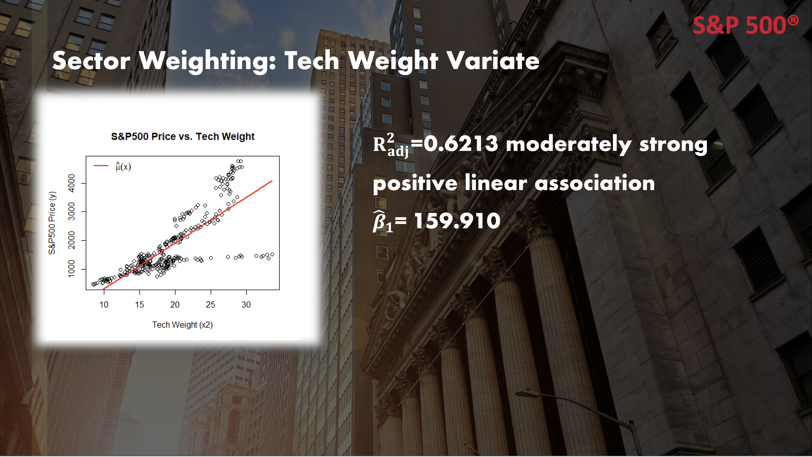

Slide 15
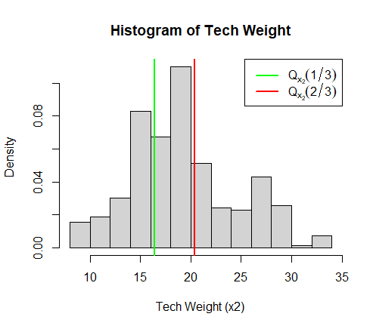


S&P 500®
Categorical Variable: Quantified Tech Weight $(x_{tech level})$
$$x_{tech level}=\left\{\begin{aligned}2 if x_{2}>Q_{x_{2}}\left(\frac{2}{3}\right) \\ 1 if Q_{x_{2}}\left(\frac{1}{3}\right)≤x_{2}≤Q_{x_{2}}\left(\frac{2}{3}\right) \\ 0 if x_{2}<Q_{x_{2}}\left(\frac{1}{3}\right)\end{aligned}\right.$$
$$R_{adj}^{2}=0.5336<0.6213$$
Implied important detail lost when we convert Tech Weight into Categorical variable.

Slide 16


S&P 500®
Model 2: Junk bond Index ${(x}_{1})$+ Tech Weight ${(x}_{2})$
$$y=β_{0}+β_{1}x_{1}+β_{2}x_{2}+ε$$
$R_{adj}^{2}=0.8757$, Higher adjected R-squared
Stronger model compared with Model 1

Slide 17


S&P 500®
Binary Variable: Yield Curve Spread
Negative Yield Curve Spread tends to be a leading indicator for recessions.
$R_{adj}^{2}=0.123$ for S&P 500 price and Yield Curve Spread is weak, so we try to turn it into binary variate
$R_{adj}^{2}=0.09397$ for $x_{yield inverted}$, even weaker than $x_{yield curve spread}$
$$x_{yield inverted}=\left\{\begin{aligned}1 if yield curve spread≤0 \\ 0 if yield curve spread>0\end{aligned}\right.$$

Slide 18
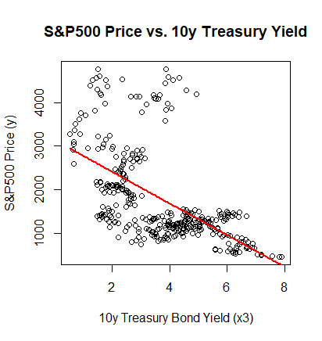

S&P 500®
Macroeconomic Covariable: 10y Treasury yield ${(x}_{3})$
All macro covariables correlated
All macro covariables have negative correlations with S&P 500 Price.
Highest correlation with S&P500 Price among all macro covariables
$R_{adj}^{2}=0.3181$

Slide 19



S&P 500®
Model 3: Junk bond Index ${(x}_{1})$+ Tech Weight ${(x}_{2})$+ 10y Treasury bond ${(x}_{3})$
$$y=β_{0}+β_{1}x_{1}+β_{2}x_{2}+β_{3}x_{3}+ε$$
$VIF\left(x_{3}\right)=2.69179$ shows moderate multicollinearity
In result, Model 3 generated by adding $x_{3}$ to Model 2

Slide 20

S&P 500®
Model 2 vs. Model 3
Suggests that even when we penalize the number of parameters, Model 3 performs better than Model 2.
Additional Sum of Squares $F$-test:
$$H_{0}:β_{3}=0 vs. H_{A}:β_{3}≠0$$
$$Under H_{0}, \frac{(SSE_{2}−SSE_{3})/(d_{2}−d_{3} )}{(SSE_{3})/d_{3}}\sim F_{d_{2}−d_{3},d_{3}}$$
$$where model M2 has sum of squared error {SSE}_{2} with degrees of freedom d_{2},$$
$$and similarly for model M3.$$
$p−value=P\left(F>239.736\right)≈0<α=5\%$ , where $F\sim F_{1,346}$
Conclusion: model Model 3 is doing a better job than Model 2.

Slide 21
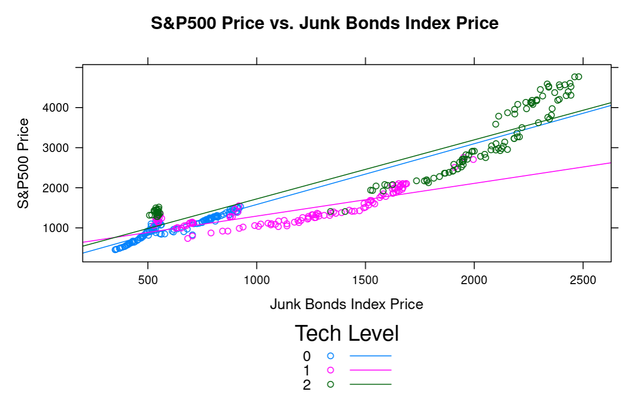



S&P 500®
Model i: Junk bond Index ${(x}_{1})$+ Interaction Term${(x}_{tech level})$
categorical tech level variate
$$y=β_{0}+β_{1}x_{1}+β_{2}x_{tech level}+β_{3}x_{1}x_{tech level}+ε$$
Interaction effect exist
Main effect exist: junk bonds index and tech level are significant to the model through R output summary
$R_{adj}^{2}=0.8845$
$$⟹\left\{\begin{aligned}&\frac{∂y}{∂x_{1}}=β_{1}+β_{3}x_{tech level} \\ & \\ &\frac{∂y}{∂x_{tech level}}=β_{1}+β_{3}x_{1}\end{aligned}\right.$$

Slide 22
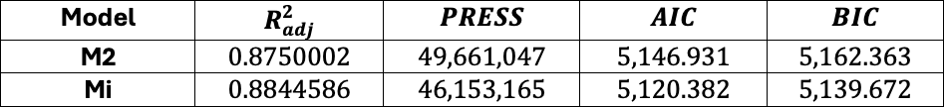
S&P 500®
Model i vs. Model 2
The higher adjusted R-squared, lower PRESS statistic, lower AIC, and lower BIC for Model i compared to Model 2 all suggest that our interaction model Model i is outperforming Model 2 on the four criteria selected.

Slide 23


S&P 500®
Model 3i: Junk bond Index ${(x}_{1})$+ Tech Level${(x}_{tech level})$+ Interaction +10y Treasury bond ${(x}_{3})$
$$y=β_{0}+β_{1}x_{1}+β_{2}x_{tech level}+β_{3}x_{3}++β_{4}x_{1}x_{tech level}+ε$$
$$R_{adj}^{2}≈0.913$$
$VIF\left(x_{3}\right)≈3.357$ Moderate multicollinearity, generally acceptable.

Slide 24



S&P 500®
Model 4: Junk bond Index ${(x}_{1})$+ 10y Treasury bond ${(x}_{3})$+ Industrial Weight ${(x}_{4})$
$$y=β_{0}+β_{1}x_{1}+β_{2}x_{3}+β_{4}x_{4}+ε$$
Strong correlations between Tech Weight ${(x}_{2})$ and Industrial Weight ${(x}_{4})$
$R_{adj}^{2}≈0.94$, M4 shows a very strong adjusted R-squared and significant linear association between the covariates in the model and the response
$VIF\left(x_{4}\right)≈2.644$, Moderate multicollinearity, generally acceptable
$C_{p}$ values of all Model 4’s subset are far from p+1=4, indicate no subset of Model 4 performing better than Model 4.

Slide 25
S&P 500®
Automatic model selection for Model 3 and Model 4
Model 4: returned by the algorithm (implemented by R) contains all the same variates
Model 3: returned with all the same variates.

Slide 26
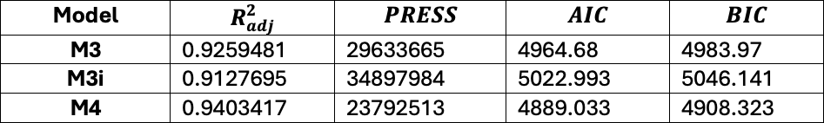
S&P 500®
Final Model Selection
Observation:
Model 4 has highest adjusted R-squared.
Lowest PRESS statistic implied least overfitting among these 3 models.
Lowest AIC and BIC.
Model 4 performance best under both model fit and model complexity consideration.
So, Model 4 would be selected as our final model.

Slide 27
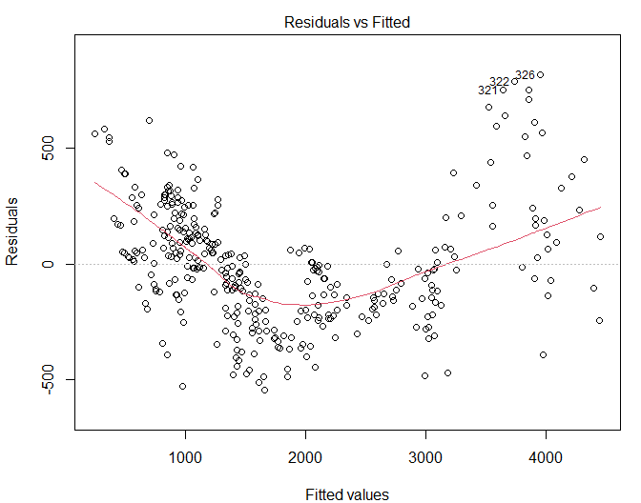
S&P 500®
Model checking for Model 4
$$y_{i}=β_{0}+β_{1}x_{1i}+β_{2}x_{3i}+β_{3}x_{4i}+ε_{i} where ε_{i}\sim N\left(0,σ^{2}\right) indepdently for i=1,…,n$$
Observed roughly the same amount of points above and below the horizontal line at zero, suggesting that the Mean of 0 assumption is not violated.

Slide 28
S&P 500®
Model checking for Model 4
Points seem to roughly follow a quadratic trend, i.e. the points do not appear completely randomly scattered.
Independence assumption is violated (since our data is time-dependent and tends to follow trends over time )

Slide 29
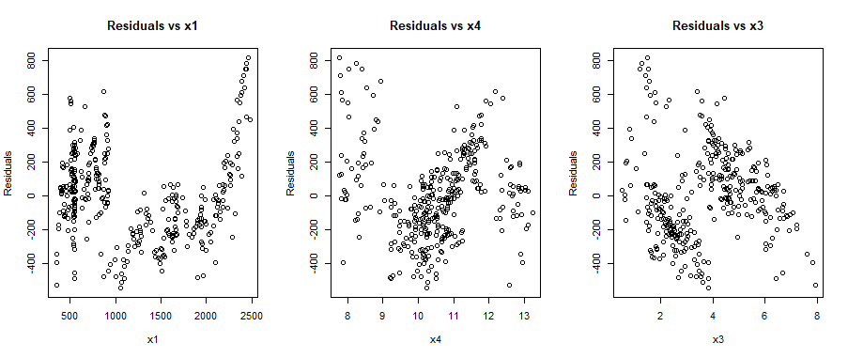
S&P 500®
Model checking for Model 4

Slide 30
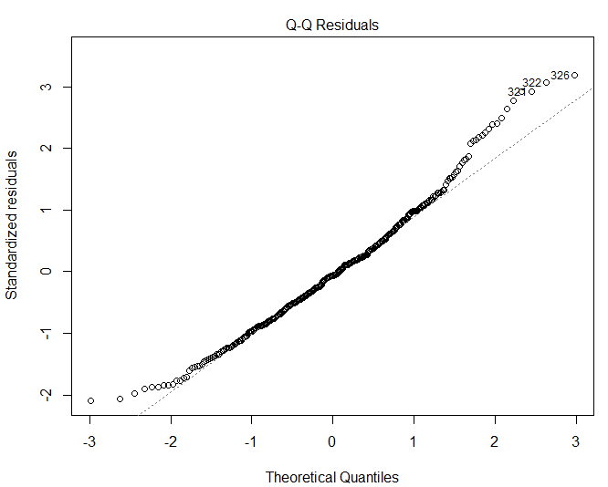
S&P 500®
Model checking for Model 4
Points on this plot lie reasonably along a straight line, suggesting that the Normality assumption is not violated.

Slide 31
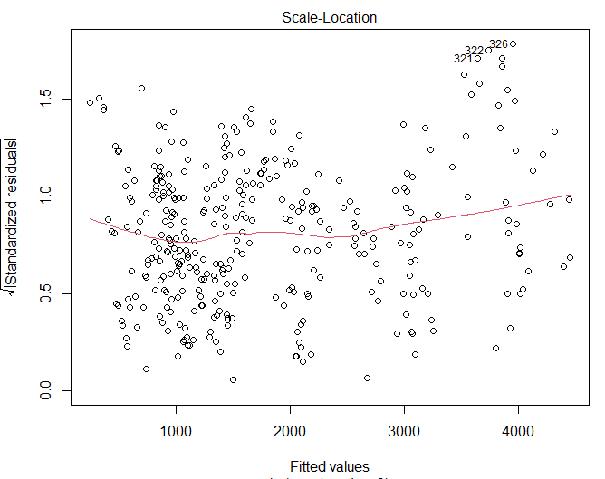
S&P 500®
Model checking for Model 4
Observed points that appear randomly scattered with no systematic trend. This suggests that the Constant Variance assumption is not violated.

Slide 32
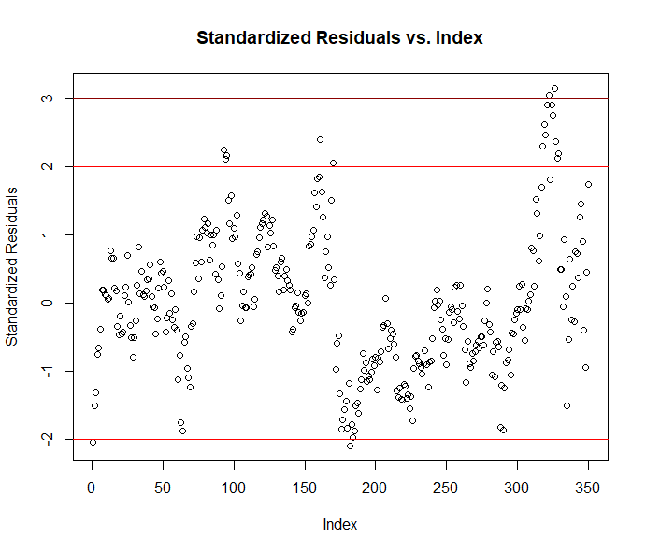
S&P 500®
Model checking for Model 4
By the empirical rule, the cases for which the standardized residual is outside the interval [−2,2] are considered outliers. From the plot, there are about a dozen cases of such outliers. Most of these suspected outliers are cases in the index range 300-325.

Slide 33
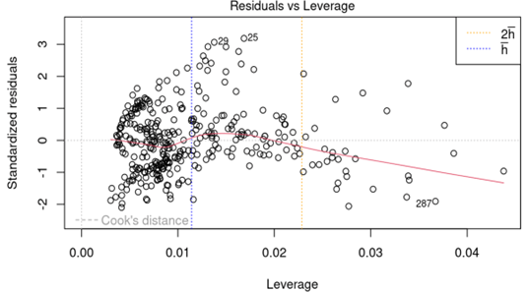

S&P 500®
Model checking for Model 4
Observed from plot that there are cases with leverage $>2\overline{h}$, which are deemed high leverage cases. However, these cases are still within Cook’s distance so there are no x-direction outliers.

Slide 34
S&P 500®
Address the Questions of interest
We found all these variables show some degree of correlation with the S&P 500 Index price, certain covariates exhibited stronger associations, and we found a lot of multicollinearity.
We selected a model without using an interaction term since it performed better.

Slide 35

S&P 500®
Transformation for final model
Independence assumption was violated, we attempt to fix this violation by transforming the response variate with the natural logarithm. We fit the model exact same model as Model 4 except for the fact that the response is now $log⁡(S\&P500 Price)$.

Slide 36
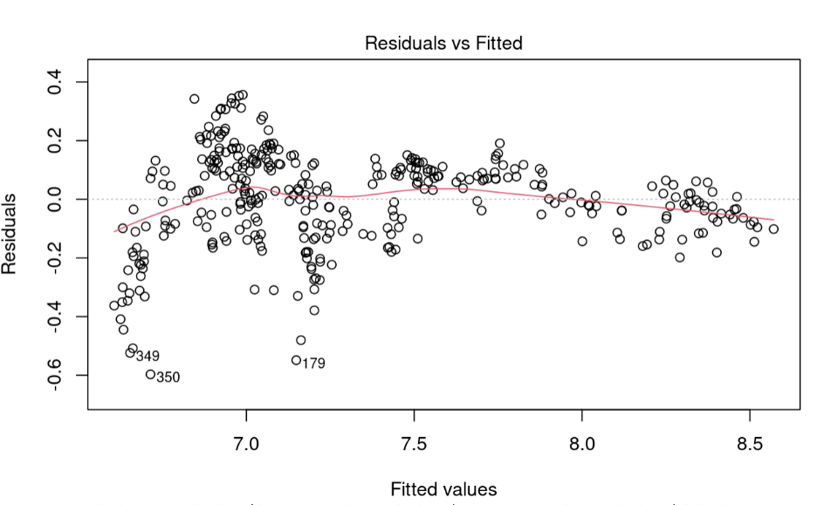
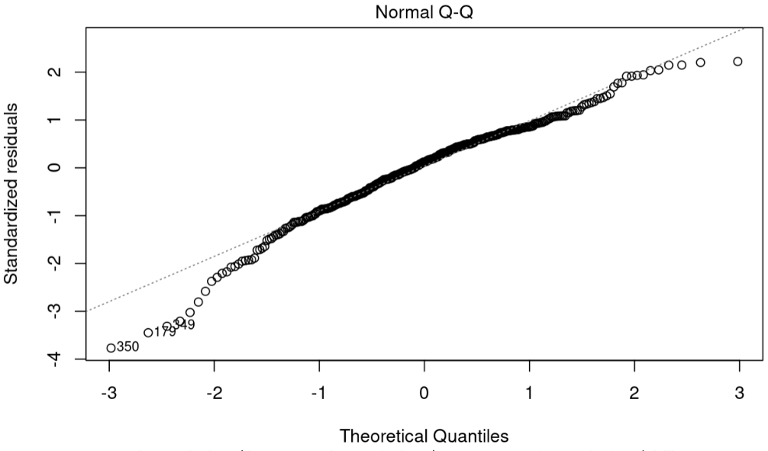
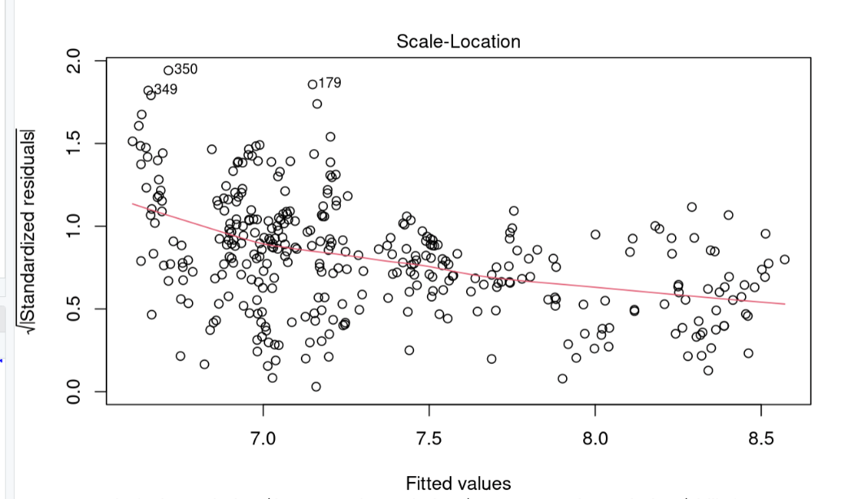
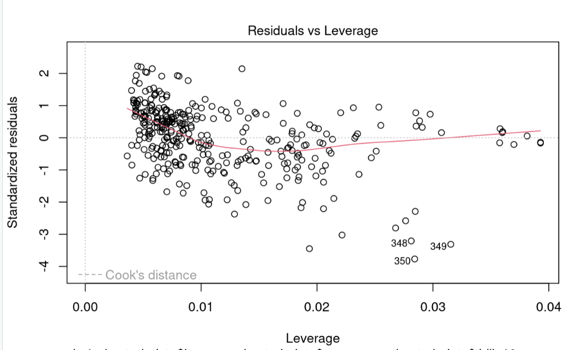
S&P 500®
Model checking for Transformation Model
The Normality and Mean of zero assumption seem to still be satisfied in the transformed model. The transformed model seems to display violation of the Constant variance assumption

Slide 37
S&P 500®
Limitation of Study
Non-Stationarity
Time Sample
Aggregation Method

Slide 38


S&P 500®
Interpretation
$$y_{i}=β_{0}+β_{1}x_{1i}+β_{2}x_{3i}+β_{3}x_{4i}+ε_{i} where ε_{i}\sim N\left(0,σ^{2}\right)$$
$$indepdently for i=1,…,n$$
$y$: S&P 500 price
$x_{1}$: price of S&P U.S. High Yield Corporate Bond Index
$x_{2}$: 10-Year Treasury Yield (in percentage points)
$x_{3}$: Industrial Sector Weighting (in percentage points)
$β$ are model coefficients.

Slide 39

S&P 500®
Interpretation
$$y_{i}=β_{0}+β_{1}x_{1i}+β_{2}x_{3i}+β_{3}x_{4i}+ε_{i} where ε_{i}\sim N\left(0,σ^{2}\right)$$
$$indepdently for i=1,…,n$$
${\hat{β}}_{0}=1928.98278$, this means the price of S&P 500 when all the other variates are zeros.
${\hat{β}}_{1}≈1.57$ suggests that a $1⬆️ in the junk bonds index price associated with a mean $1.57 ⬆️ of S&P 500 price, holding $x_{4}$ and $x_{3}$ constant.
${\hat{β}}_{2}≈−288.43$ suggests that a 1% ⬆️ of industrial Sector weighting of S&P500 is associated with a mean $288.43 ⬇️ in the S&P500 price, holding $x_{1}$ and $x_{3}$ constant.
${\hat{β}}_{3}≈269.29$suggests that a 1% ⬆️ in the 10-year treasury yield is associated with a mean $269.29 ⬆️ of S&P500 price, holding $x_{1}$ and $x_{4}$ constant.
Note: “1% ⬆️”, mean that the value increases from $k\%$ to $\left(k+1\right)\%.$

Slide 40



S&P 500®
Applications
S&P 500 Price Forecasting
Portfolio Management and Strategy
Policy and Risk Analysis

Slide 41
S&P 500®
Conclusion
Despite attempts to address the issues with model transformation, the assumptions remain violated. The final model fails to meet the model assumption, which indicates that the model might not be practical in real life, further investigation and application should be done with precaution.

